Slide 1
Image Retrieval

Slide 2
Contents
1、Structure
1.1 Perceptual Hash Algorithms
1.2 Content-Base Image Retrival
1.3 Assessment of the Current Algorithm
2、Directions

Slide 3
Perceptual Hash Algorithms（PHA）
Average the colors
Compute the bits
Reduce size
Reduce color
Construct the hash
Compute the DCT
Reduce the DCT
Further reduce the DCT
Simple and high efficiency but low robustness

Slide 4
Content-Base Image Retrival（CBIR）
Application:
Dataset of Images
Image Representation
Store Indexing
Google Images
Bing Images
TinEye
Pixsy
eBay
Amazon
Alibaba
Taobao
JD.COM
etc….
User Submits Query Image
Image Representation
Image Scoring
Database of index
Display Results to User
Search Reranking

Slide 5
Assessment of the Current Algorithm
Hand Crafted Feature
Learning-based Feature
VGG16 finetune
Dataset of Images
Image Representation
Store Indexing
Author: Yong Yuan
A student
Open source in 2015
No article support
Demo for CBIR
User Submits Query Image
Image Representation
Image Scoring
Database of index
Distance Based Scoring
Voting Based Scoring
Cosine
similarity
Display Results to User
Search Reranking

Slide 6
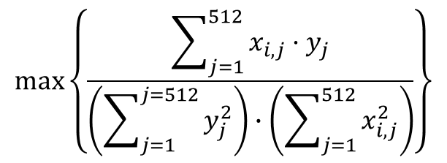




Assessment of the Current Algorithm
Dataset of Images
Image Representation
Store Indexing
where time spends
User Submits Query Image
Image Representation
Image Scoring
Database of index
Large scale matrix calculation
$$IMG$$
Display Results to User
$[1,512]⨉$[512,N]=[N]
Search Reranking
$$max\left\{\frac{\sum_{j=1}^{512}{x_{i,j}·y_{j}}}{\left(\sum_{j=1}^{j=512}{y_{j}^{2}}\right)∙\left(\sum_{j=1}^{512}{x_{i,j}^{2}}\right)}\right\}$$
$$VGG_Net$$
$$[1,512]$$
Cosine similarity

